Slide 1


Augmented Reality Gardening App

Slide 2
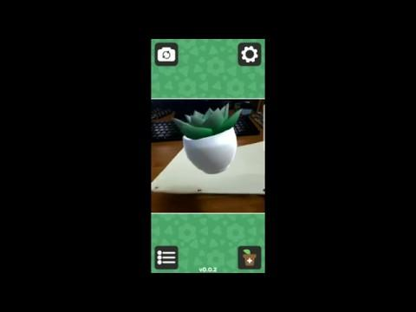
Notes:
Quick gameplay demo
-Do you wish having houseplants was even easier?
-Introducing gARden, an augmented reality houseplant app
-Pop in your email, and you’re all set to get planting
-We have a lot of options, in this demo we choose a sunset succulent.
-It creates a middle marker, previewed in the bottom-right
-we print it out, and bam! There’s the plant, motion tracked in real time!

Slide 3
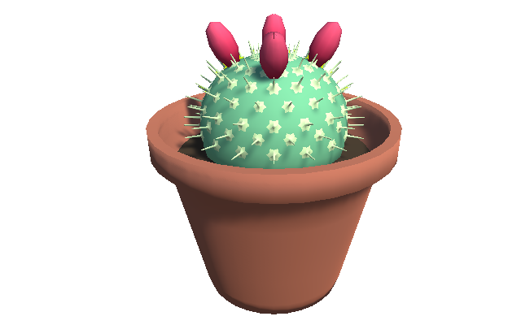
The Basics
Augmented Reality gardening application
Select plant species and pottery
Marker pattern representing plant is emailed to you
Print out physical markers that act as “flowerpots”
View marker through app to bring it to life!
Tap plants to interact
Tend to plants to speed their growth
Plants grow in real time
Can never die, only grow more slowly
Notes:
-AR using CV
-Receive marker print-out via email
-Viewing through the app brings the plant to life
-Plants grow in real time at various speeds, but can never die (only progress very slowly)

Slide 4
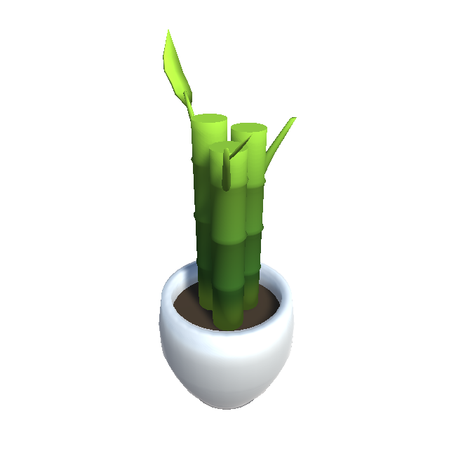
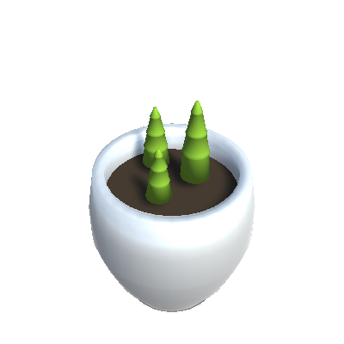
The Core Game Loop
Plants grow faster based on “Affinity”
Affinity gained through positive interactions
Affinity decays over time
Plants have “Personality” values
Personality adds unique variance to plant preferences
Plants can propagate after growing
Seeds, leaf clippings, flowers, etc
Can be traded to other players
Notes:
-Positive Interactions like: watering on time, not too often
-Personality impacts how often plants like to be watered
-Propagations can be traded to other players as part of a social mechanic
-Propagations contain entire family history of plant
-Can scan a code that lets you see friend’s garden

Slide 5
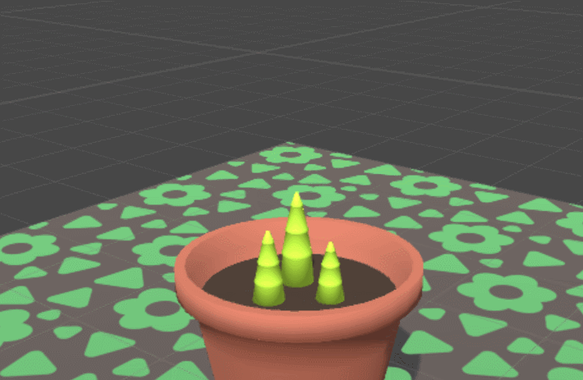
Notes:
As we mentioned, plants grow in real time. Here’s an example of that! In a sense, I guess we’ve made a game of watching the grass grow.
In addition to just growth, you can watch flowers bloom in real time, or leaves unfold.

Slide 6
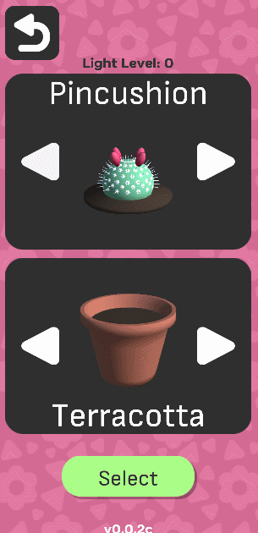
Monetization
Base app free on mobile
All plants unlocked by default
Terracotta, Ceramic + 2 random pots unlocked
3 plant slots available
Premium Currency: Sunshine Coins !
Earned slowly over time
Earned faster in well-lit environment
Mostly cosmetic IAPs
New pots designs
Seeds that guarantee a plant color
Additional plant slots
Notes:
-currency of SUNSHINE COINS
-buy coins or earn then gradually over time
-increased rate in sunny/well-lit areas (using device light sensor)

Slide 7



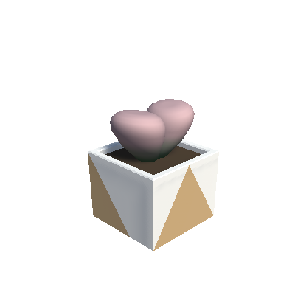
Release Goals
Casual player audience
Low stress, low maintenance, short play intervals
Older demographic
Targeting major mobile platforms
Desktop build possible for itch.io
Game works with standard webcam
All IAPs unlocked in desktop version, costs upfront instead
Notes:
-This game is aimed towards the very casual audience.
-As an anecdote, this game is inspired by my dad, who became a semi-professional bonsai grower after I left for college.
-His office and our garage back home are filled with tiny pots full of trees and other plants.
-I wanted to make a game that would let other people experience the joy that he finds in his plants, without needing to have that level of devotion to the craft.

Slide 8
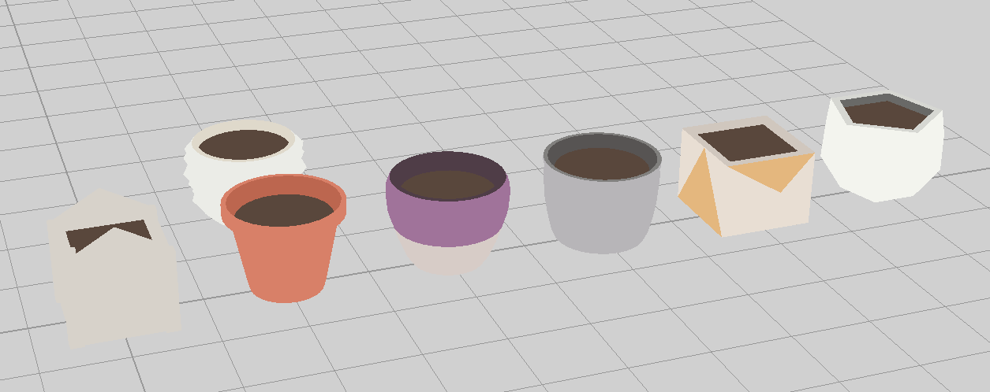



Timeline
Started in mid-January
Currently Done
Computer Vision + AR Tracking
Marker generation + email distribution
4 plant varieties + 7 pottery options
Basic interactions
To Be Done
More plant varieties + pottery options
Robust interactions
IAP shop integration
Social integrations
Localization
Notes:
We started only about a month and a half ago, but we’re making good progress
Social Media integration is planned, namely photo sharing (insta/twitter/pinterest) There’s a really big Succulents community on Pinterest, we found!
We also have the basic hooks for localization. Currently, the game has partial support for Italian and Chinese!

Slide 9




Questions?
@SunshineDevs
sunshinecommitee.io
devs@sunshinecommittee.io

